Slide 1

Just-in-Time Intervention
Sub Team Presentation-2

Slide 2
Introduction

Slide 3



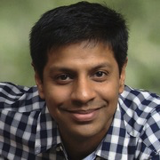

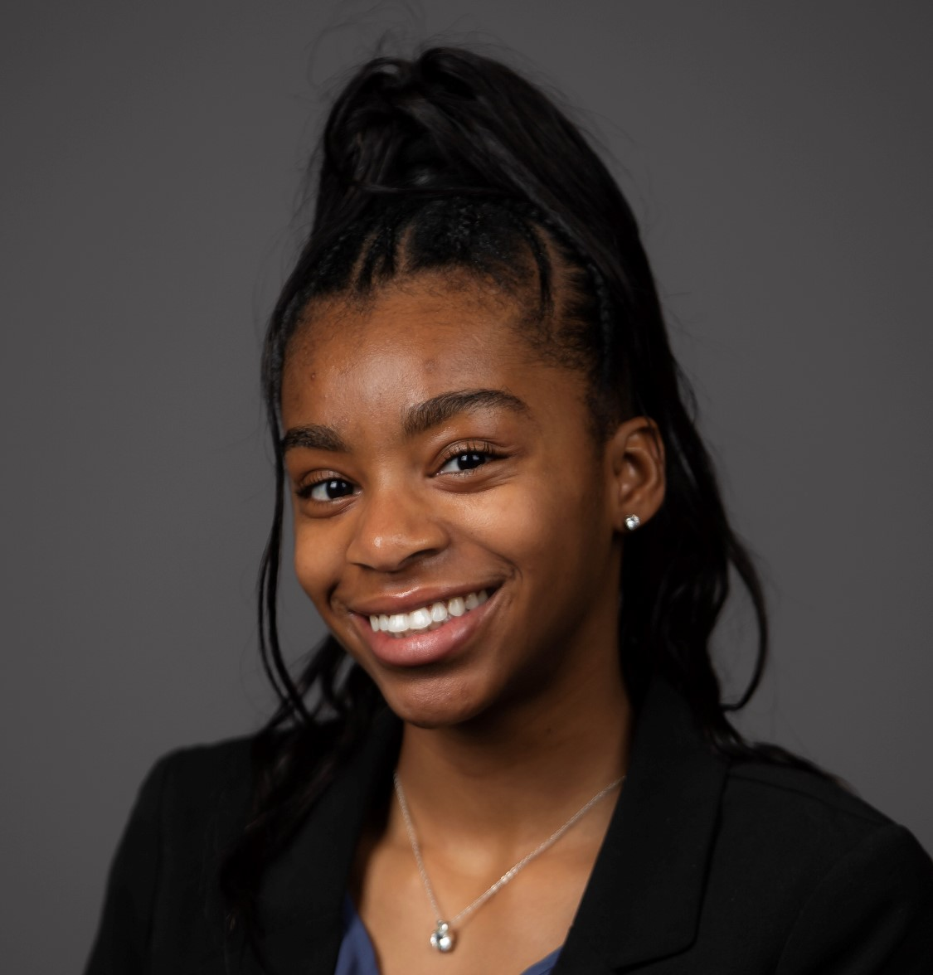
Meet the Team!
Attush
Ania
Aashay
Saurabh
Lindsey
Cindy

Slide 4
Background of Project
❖ Goal
➢ Build a web application that predicts student outcome for any given course using a machine learning model.
❖ Outcome
➢ A Minimal Viable Product that predicts student outcome based on student grades and engagement data (attendance, click stream, log-in duration, etc) for any given course
Notes:
Saurabh

Slide 5
Data Modeling Team

Slide 6

Data Modeling Team: Goal
Model Evaluation
Time Series
Compare
Goal : Apply predictive modeling techniques from previous semester to new dataset and compare the results of the two course to find correlations and patterns.
Paper: Student success prediction in MOOCs by Gardner & Brooks (University of Washington)
Goal : Evaluate the impact of time series clickstream data on predicting course progress and student success
Paper: Behavior-Based Grade Prediction for MOOCs via Time Series Neural Networks by Tsung-Yen Yang, Christopher Brinton (Princeton University)
Goal : Compare our results with a similar research
Paper: Mass attrition: An analysis of drop out from a Principles of Microeconomics MOOC by Rebecca M Stein and Gloria Allione (University of Pennsylvania)
Notes:
Lindsey

Slide 7
Progress Since Last Presentation
Time Series Modeling
Data transformation
Explore & implement Null removal techniques and find the best approach to remove null values from various input variables.
Explore & implement outlier removal techniques and find the best approach to remove outliers from the data
Regression Modeling on Aggregated non-STEM Data
Implement various regression modeling technique on the MGT100 dataset
Compare STEM and non-STEM results
Compare the demographics data between CS1301 and MGT100 through visualizations
Run unsupervised learning technique to MGT100 and compare against CS1301.
Run supervised learning technique to MGT100 and compare model performances from CS1301
Compare the important features determined in CS1301 with that of MGT100
Notes:
Cindy: Since our model from last semester was not in the form of a time series, it was only able to calculate its results after the class has concluded.
This semester we will develop our existing model to allow for results throughout the course so that the student or instructor can receive real time updates on their progress. We want so see if the the model is still efficient in this case.
We also want to test our model on a non stem course to see if the model correlates in class with different objectives. So last semester we were testing on CS course. This semester we will see how it fairs on a management course.

Slide 8
Data Wrangling
Missing Values
MGMT100 Course Data
There were 127 records that had missing user_id.
MNAR → Replaced all the records with missing user_id with specific user_id.
CS1301 Course Data
There were 10322 records that had missing user_id.
MCAR → Removed missing records with missing user_id
Outlier Detection
Visualized outliers using Box Plots & Histograms
Obtained context on existence of outliers to determine handling decision
Outlier Handling
Removed outliers using IQR
Notes:
Cindy:
Missing Values
We started with of course cleaning up our data. Both the CS and MGMT course data contained missing data in the user_id column.
It was hard to tell at this stage if there was any bias in the missing user_id values that could affect our decision on how we clean this missing data because we have not yet combined the course data with the demographics data.
For this reason, after obtaining context on the nature of the missing data, we conclude that for the management course, the data was missing not at random and replaced it with a specific user_id based on the provided context while for the CS course we concluded that the data was missing completely at random and felt comfortable removing all the records with missing user_id.
When it came to detecting and handling outliers, we noticed the MGMT had a significant number of outliers compared to the CS class. In the end we proceeded to removing the outliers for now, as we have yet to combine with the demographics data to determine bias relative to the progress and grade in class.

Slide 9
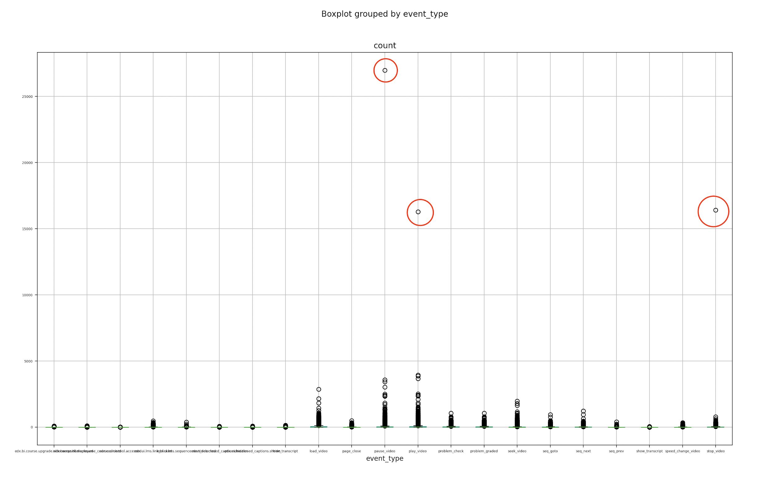
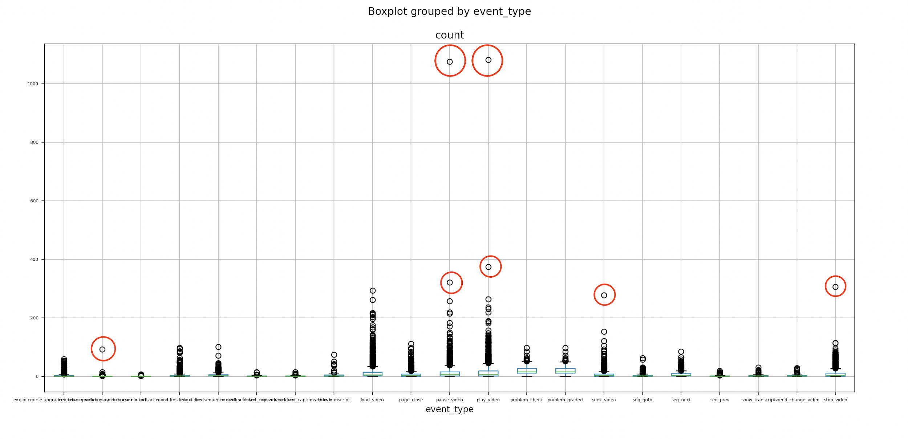
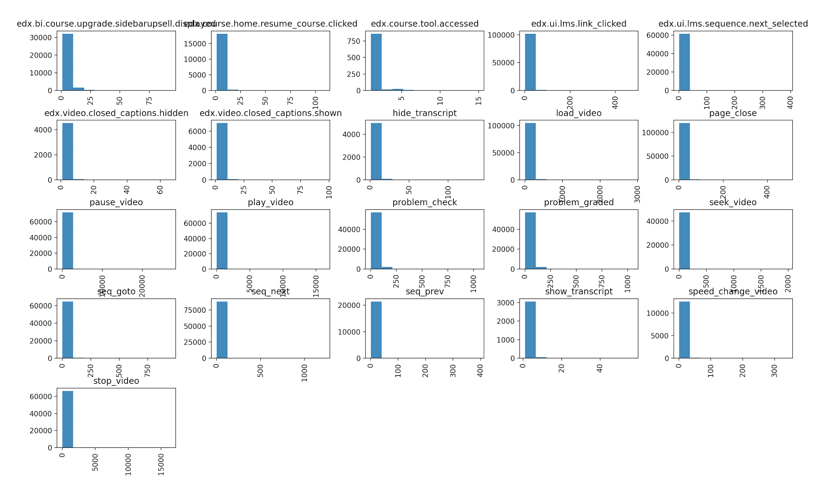
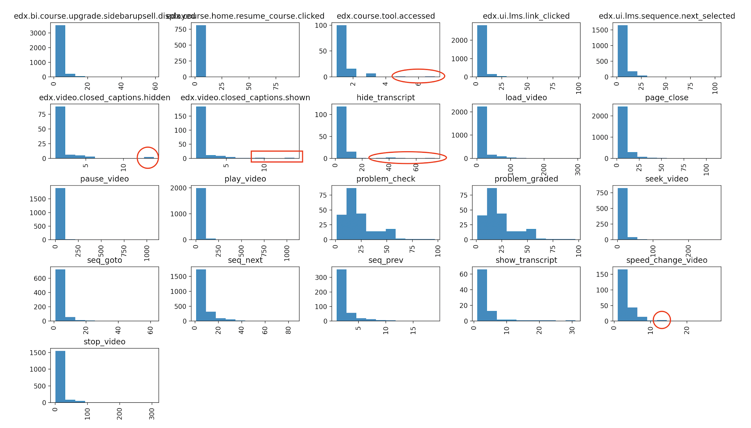
Data Wrangling
CS1301
Outlier identification
MGT100
Notes:
When it came to detecting and handling outliers, we noticed the MGMT had a significant number of outliers compared to the CS class. In the end we proceeded to removing the outliers for now using Inter Quatile range method, aligned with how we visually identified the outliers., The reason being that given that we have yet to combine with the demographics data to determine bias relative to the progress and grade in class it will be sufficient for now.

Slide 10
Data transformation
Formatting
Pre-processing the raw data to convert it to dataframe.
The original dataset had random data in excel separated by empty columns.
Pivoting event type rows to columns (features)
Renaming the cryptic column names to more readable formats for easy comparisons between the STEM and NON-STEM Course.
Convert to Time Series
Accumulate the clicks for each user over time
Using Cumulative Sum of each events week over week.
Next Steps
Prepare to move data forward the for each users where activities are missing in a week.
Notes:
Lindsey: CS1301 Course Data
There were 10322 records that had missing user_id.
Removed all missing records (After investigation and obtaining context about the data and given the size of the data at 1million + records)
Next steps for demographics data and combining
For the next steps, We will be performing a similar analysis for the missing values on the demographics data for each of these classes.

Slide 11
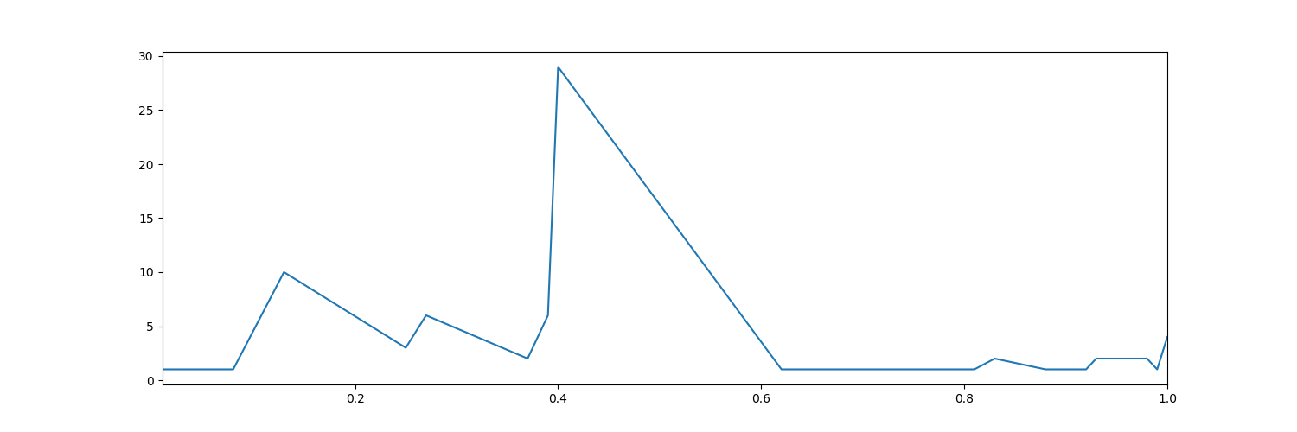
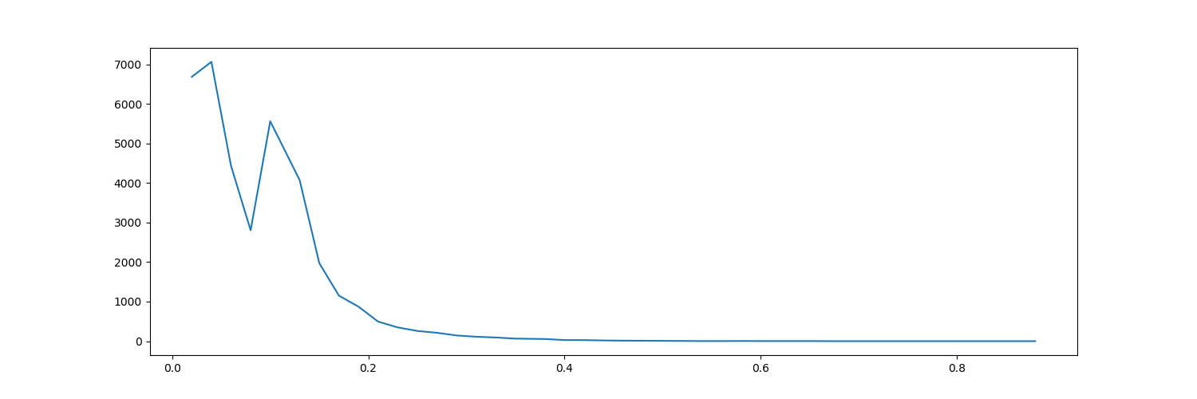
STEM vs Non-STEM Data Comparison
MGT100
STEM Course(CS1301) overall had very low progress with a mean of 10%
Non-STEM Course (MGT100) had higher progress with a mean of 50%
CS1301
Notes:
Lindsey

Slide 12
STEM vs Non-STEM Demographics Comparison
Measure | CS1301 | MGT100
Male % | 65% | 43%
Female % | 17% | 15%
Bachelor Degree | 30% | 17%
Master Degree | 18% | 24%
Phd | 3% | 8%
US Students | 24% | 31%
Female % is similar
Bachelor Degree % is higher on the STEM course and Master Degree% was higher in the non-STEM course.
% of US students are similar
Notes:
Saurabh

Slide 13
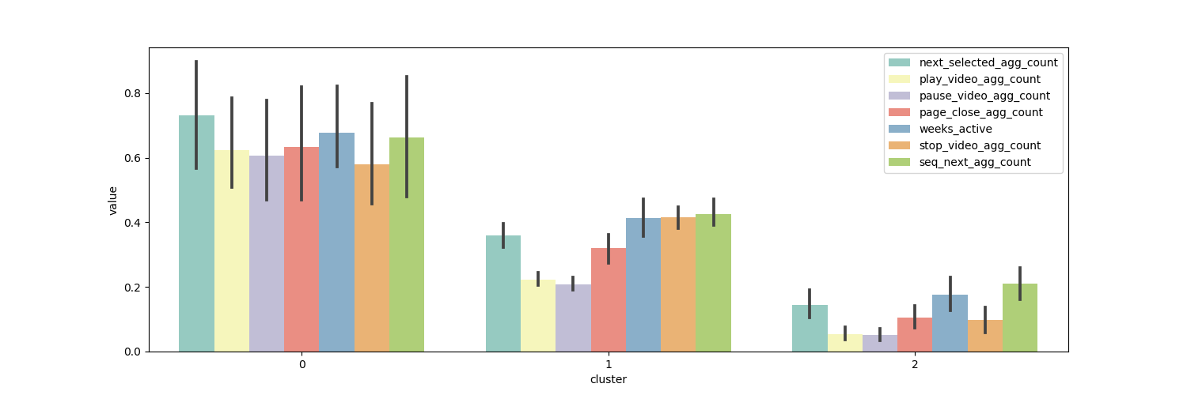
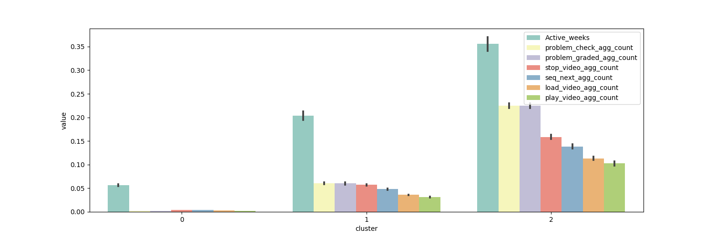
STEM vs Non-STEM Cluster Comparison
Elbow method determined 3 clusters in both STEM and non-STEM
Cosine k-means worked better on both dataset
Similar features contributed to the cluster
In the Management course the Standard deviation of the features on the cluster 0 was high.
The 3 clusters had a mean progress that can be categorized as low, medium and high.
MGT100
CS1301
Notes:
Saurabh

Slide 14
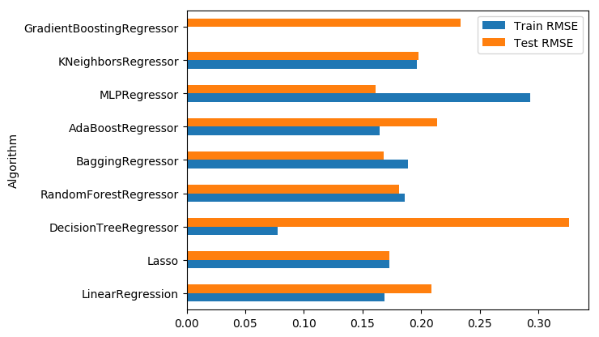
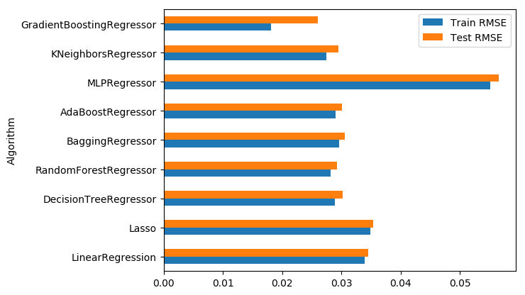
STEM vs Non-STEM Regression Model Comparison
MGT100
CS1301
Gradient Boosting performed best for both STEM and non-STEM
On an average RMSE was higher in the non-STEM course, likely because of low volume of data.
Notes:
Saurabh

Slide 15
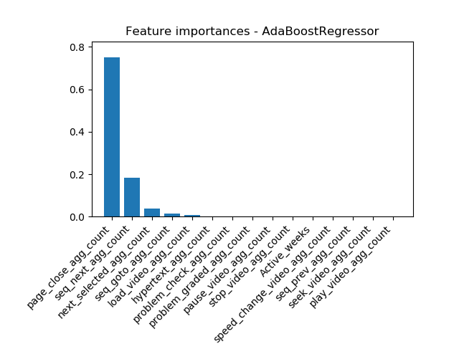
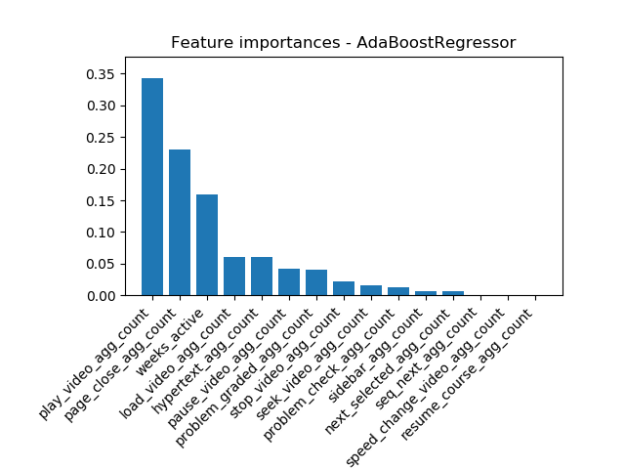
STEM vs Non-STEM Best Feature Comparison
CS1300
MGT100
Interestingly, Page Close was one of the most important features for STEM and non-STEM
Some other tops features in both the courses - Next Sequence, Weeks Active, Load Video
Notes:
Saurabh

Slide 16
Whats next?
Training model on time series data.
Since data imbalance exists and the total sample space for the Management course is less, we will apply techniques to add synthetic data.
Similar Issues reported in paper: Dropout Prediction over Weeks in MOOCs via Interpretable Multi-Layer Representation Learning( Carnegie Mellon University, Pittsburgh, PA)
Determine minimum amount of data(weeks) required for accurately predicting final progress.
Evaluate the use to true time series modelling techniques like CNN and RNN
Notes:
Saurabh

Slide 17
Web Development Team

Slide 18
Web Dev Team: Goals
Build a new instance of the web application
This instance will be the production application (prod. server)
Current instance will act as dev server
Allow us to write code, test and iterate without affecting the end users
Once the testing is done, we can push the latest changes to prod. Server
Notes:
Attush

Slide 19
Progress Since Last Presentation
CSS Bootstrapping
To improve our aesthetics, we have written new css classes
The new css classes that will be used for production app
UX Analysis
Research Interview Feedback
LTI Integration
Next steps
Notes:
Ania : Since our model from last semester was not in the form of a time series, it was only able to calculate its results after the class has concluded.
This semester we will develop our existing model to allow for results throughout the course so that the student or instructor can receive real time updates on their progress. We want so see if the the model is still efficient in this case.
We also want to test our model on a non stem course to see if the model correlates in class with different objectives. So last semester we were testing on CS course. This semester we will see how it fairs on a management course.

Slide 20
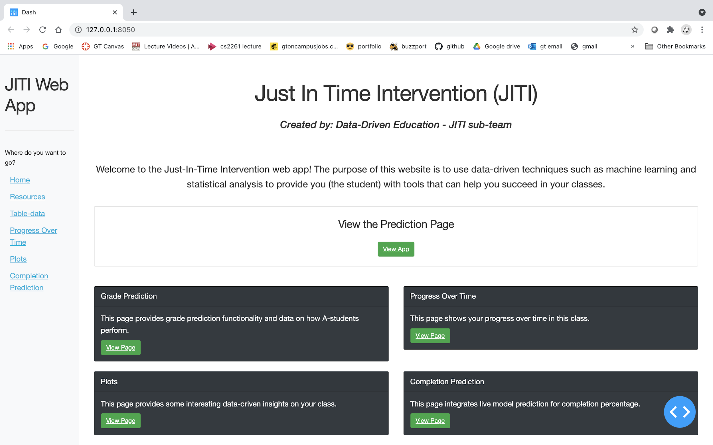
Web Dev Progress
Trying to change the UI to wireframe (next slide)
We wrote css classes but the app is complex so we decided to create a new instance of the app which will also serve as production server
Current landing page
Notes:
Attush

Slide 21
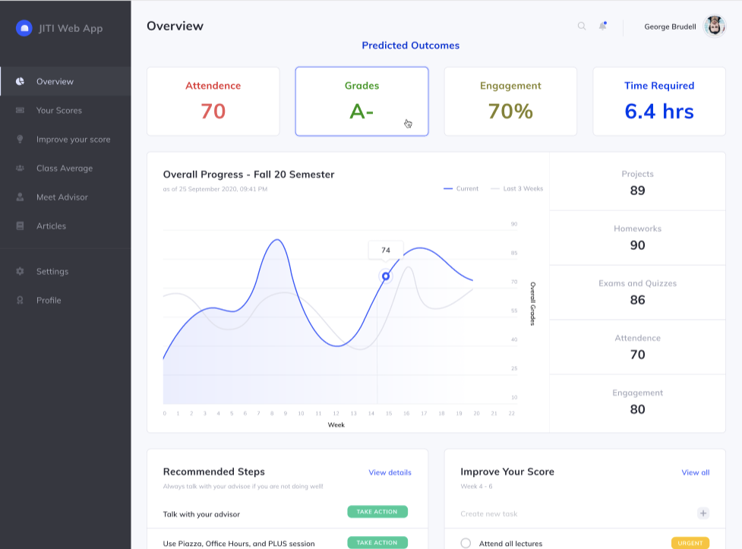
Wireframe

Slide 22
UX Analysis - Research Interview Results
Reviewed wireframe with Sonam
Feedback by page
Overview
Overview page should be more informative than interactive
Performance
Include more course specific information, and consider using icons to alert students of low class grades
Improve
Elaborate on the specific actions that students can take to improve their grade
Profile
Consider adding a feature to let students change their profile picture
Settings
Add a way for students to enable push notifications
Notes:
Attush

Slide 23
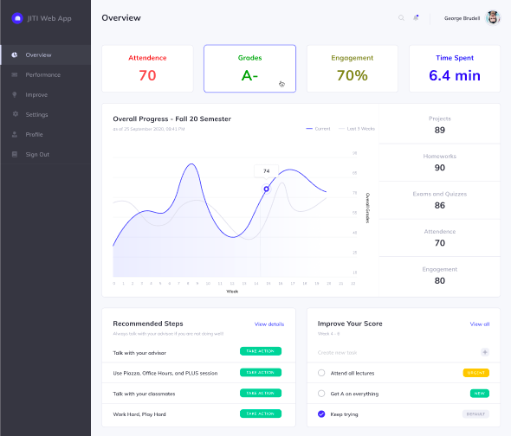
Overview Page
Should be more informative than interactive
Potentially replace with improvement plan reminders
Notes:
Ania

Slide 24
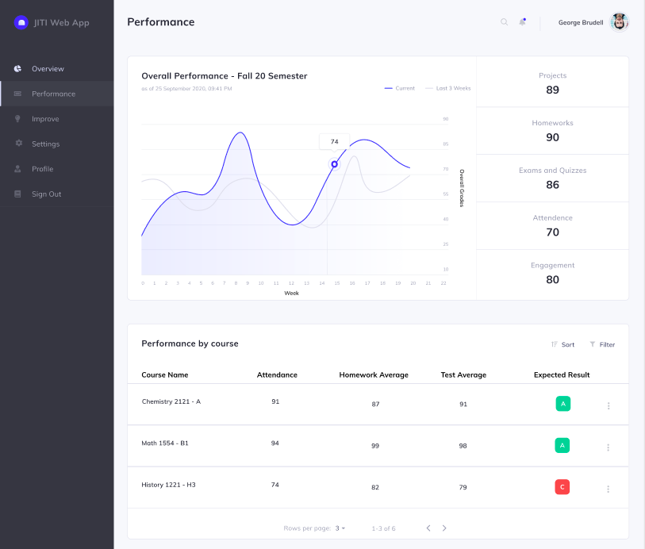
Performance Page
Consider course specific graph updates
Include options for other course information
Notes:
Ania

Slide 25
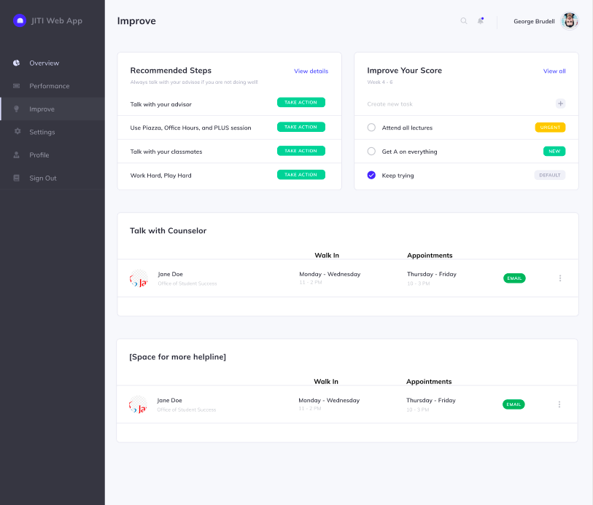
Improve Page
Minimize interactions
Consider joining student created goals with recommended tasks to improve
Replace urgency flags with icons/highlight
Notes:
Ania

Slide 26
LTI Integration
The Goal: Use Canvas LMS API in order to authenticate access to our webapp
Motivation: Due to our web app containing sensitive information, we thought it would be best to allow access to people through Canvas’s OAuth API. This way we can guarantee the identity of the users of this webapp. Once this is implemented, we can also possibly apply our models and analyze information if MOOCs were offered through Canvas.
The Process:
First, I spent time reading through documentation to get a grasp on the general sense of OAuth and how Canvas LTI works.
Useful links from Emily Reese’s powerpoint
Then, I spent time going through github repos implementing Canvas LTI API
Notes:
Aashay

Slide 27
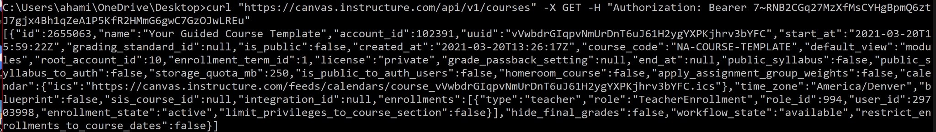
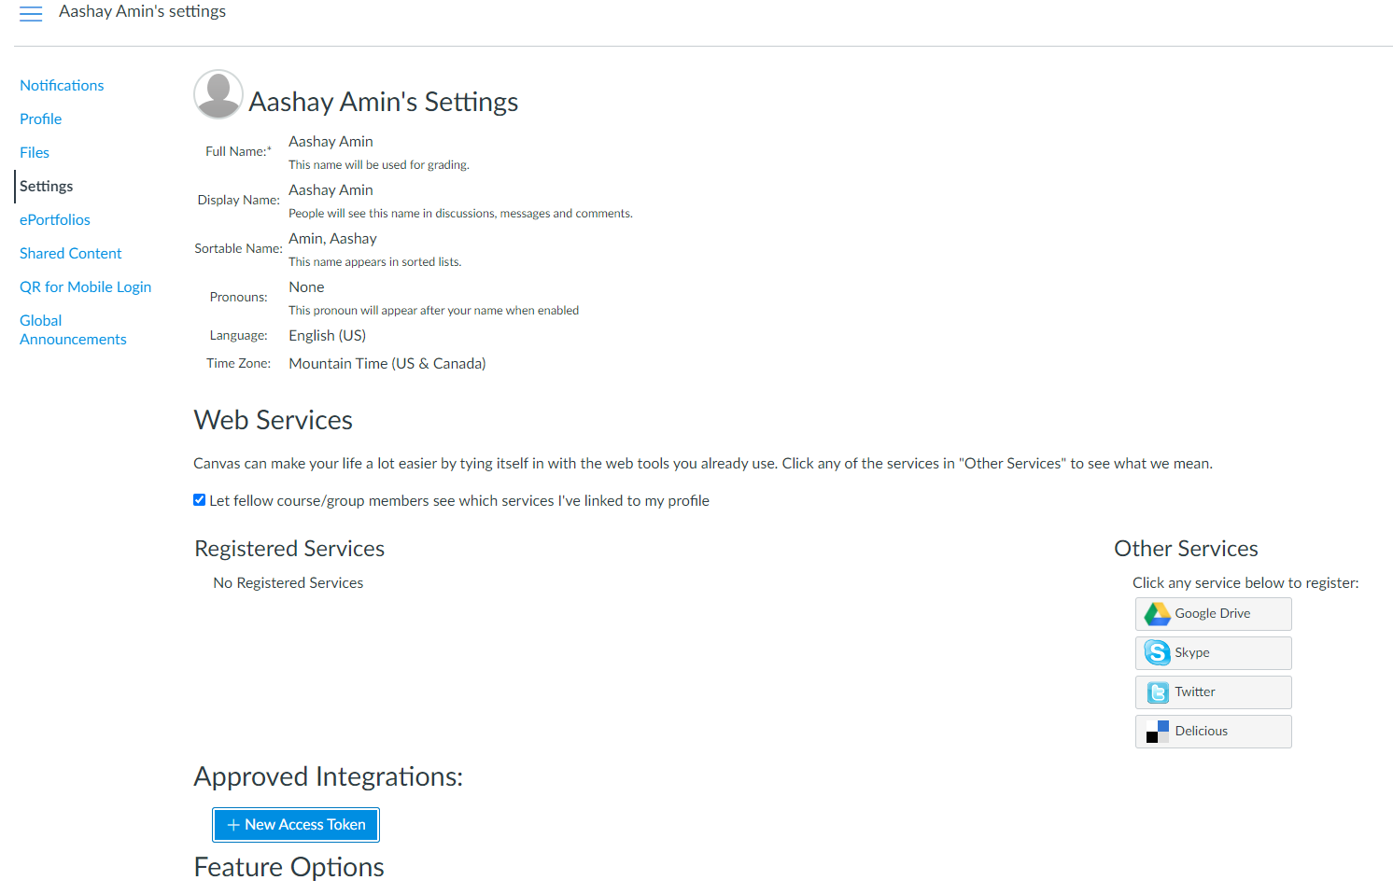
LTI Integration
The Process (Cont’d):
I created a free canvas account to get teacher access. In this account, I registered a token to be able to perform API call. Along with this, I started writing scripts in order to test out the API.
Notes:
Aashay

Slide 28
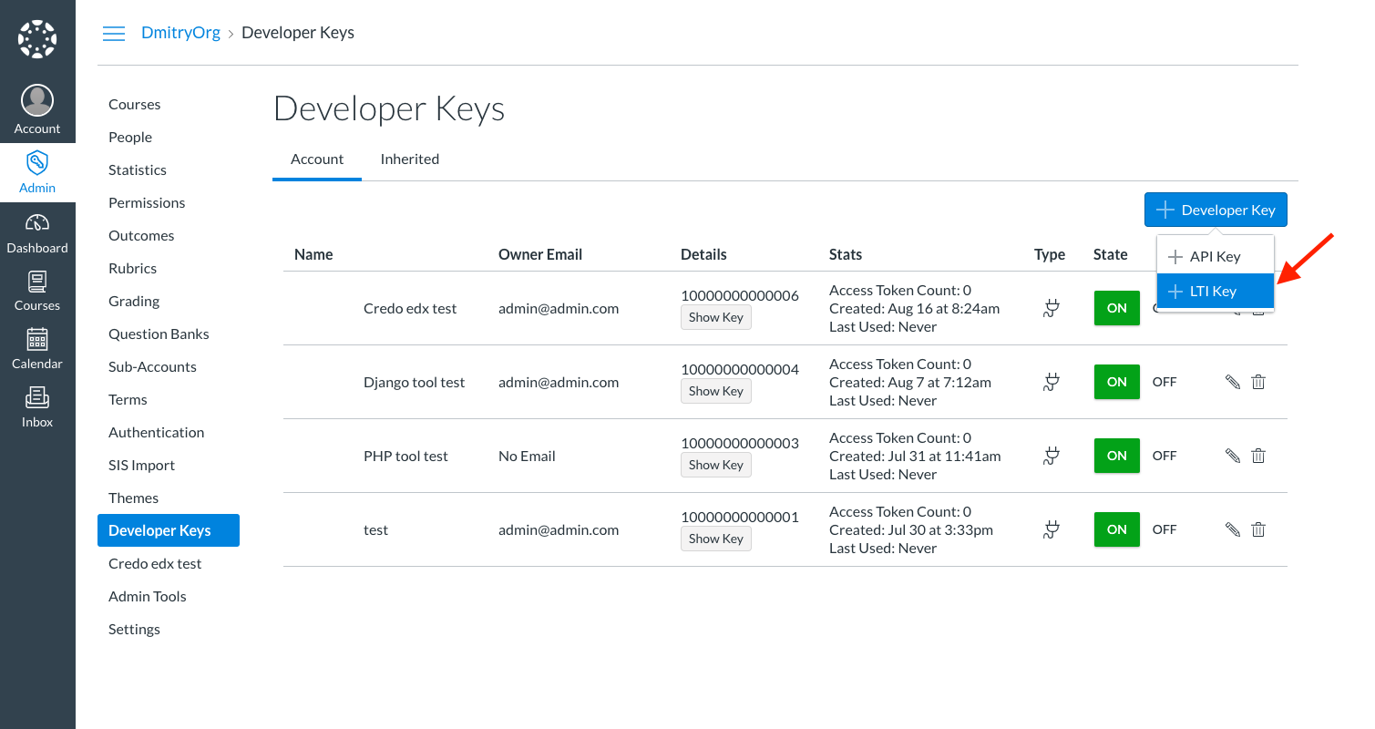
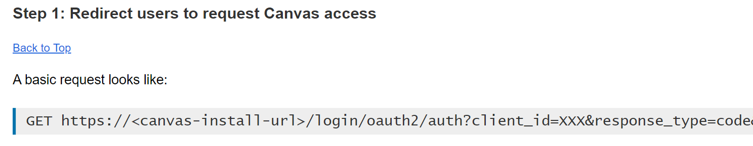
LTI Integration
The Issue:
In order to make API calls for OAuth, you need to register an LTI Key to get a client_id and secret. This can only be managed by an Admin of a canvas account, which cannot be done for free, and GT cannot offer to students for research. So, it looks like we will not be continuing with Canvas LTI Integration for now.
Notes:
Aashay

Slide 29
Whats next?
Complete documentation for LTI
Encapsulating models within classes instead of having the raw code exposed in the backend
Looking into any best practices around this
Adding to the insights
Adding more images and insights to associated page from the results produced by the ML team
Notes:
Aashay

Slide 30
Conclusion
Model-training team
Compare behavioral patterns to predict student outcome for a STEM and Management course
Build a time series prediction model to predict path forward from point of time data.
Provide a mechanism for the front end to query what-if scenarios for a student for a given week.
Web Development Team
➢ Research UX changes to improve wireframes
➢ Implement wireframes to frontend
➢ Implement LTI Integration for login flow
➢ Implement querying of model and what-if scenarios for a student for a given week
Improve Documentation and Handoff strategy
Notes:
Saurabh

Slide 31
Resources
General Resources
“Student Success Prediction in MOOCs” by Josh Garner and Christopher Brooks: https://arxiv.org/abs/1711.06349
ML Research Resources
“Behavior-Based Grade Prediction for MOOCs via Time Series Neural Networks” by Tsung-Yen Yang, Christopher Brinton(Princeton University): https://ieeexplore.ieee.org/document/7917237
“Mass attrition: An analysis of drop out from a Principles of Microeconomics MOOC” by Rebecca M Stein and Gloria Allione(University of Pennsylvania): https://economics.sas.upenn.edu/sites/default/files/filevault/14-031.pdf
UX Research Resources
“Motivating Students In Massive Open Online Courses (MOOCs)” by Kun Lee and David Richard Moore: https://www.oerknowledgecloud.org/archive/Li-Moore2018_Article_MotivatingStudentsInMassiveOpe.pdf
“No single solution helps all students complete MOOCs” Cornell University: https://www.sciencedaily.com/releases/2020/06/200615152116.htm
Notes:
Saurabh

Slide 32
Thank you!!

